Slide 1

FACE RECOGNITION ATTENDANCE SYSTEM
SCHOOL OF ENGINEERING
DEPARTMENT OF COMPUTER SCIENCE & ENGINEERING
By
Kata Nithin – 227Z1A0576
Lakkakula Bindu – 227Z1A0591
Kommarajula Praveen – 227Z1A0582
Under the Guidance of
Mr. S. Srikanth Reddy
(Assistant Professor)

Slide 2
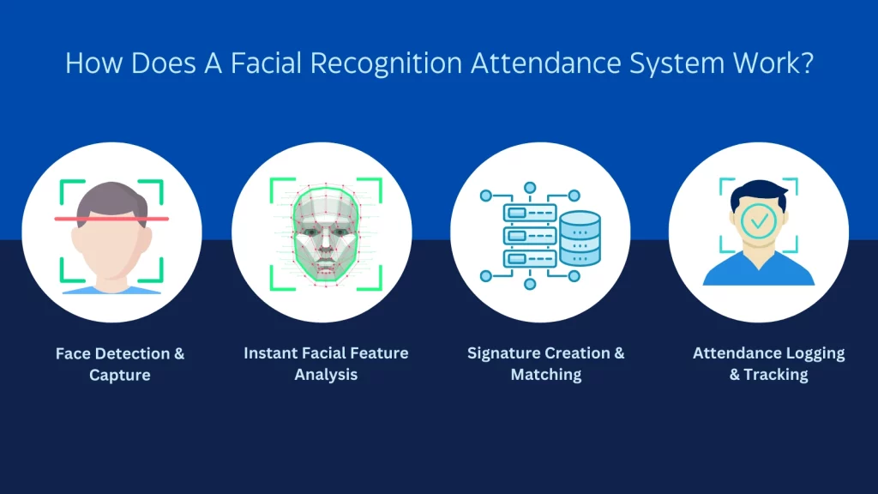
Abstract
The “Face Recognition Attendance System” provides a contactless and automated solution for attendance management
It is developed using Python, the system incorporates OpenCV for real-time image processing, Face recognition and NumPy for Computational tasks.
This model reduces the challenges such as impersonation buddy punching and manual errors.
This system enhances efficiency and accuracy.

Slide 3
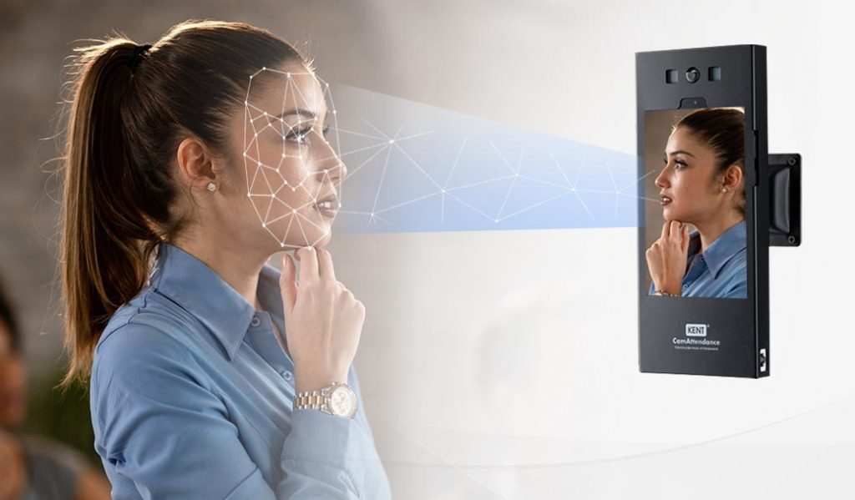
Problem Statement
Traditional attendance systems often rely on manual system or biometric methods like fingerprint scanning, which can be time-consuming, prone to errors. With the help of face recognition technology, there is an opportunity to create a more efficient, accurate, and user-friendly attendance system.

Slide 4
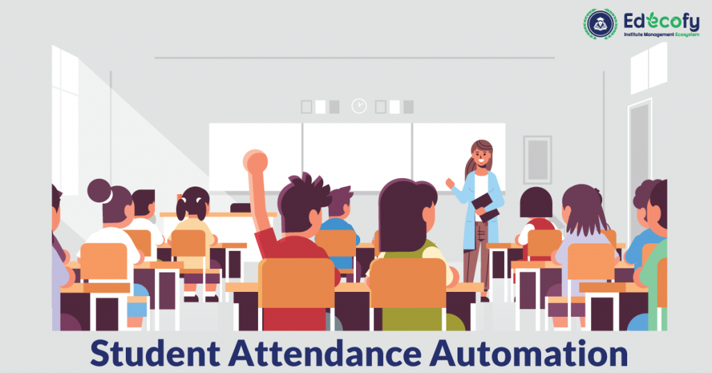
Existing System
Manual attendance system.
Biometric attendance system.
RFID attendance system.

Slide 5


Disadvantages
Privacy Concerns
Cost and Infrastructure

Slide 6
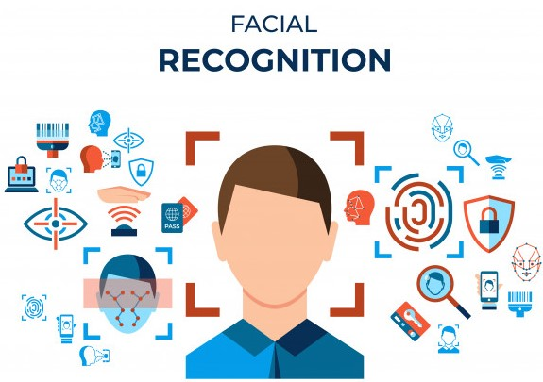
Proposed System
Face recognition system leverages machine learning, deep learning, and image processing to accurately recognize and classify faces.
Capture an image , Analyze key facial features, and compare them with already stored data to determine identity.

Slide 7
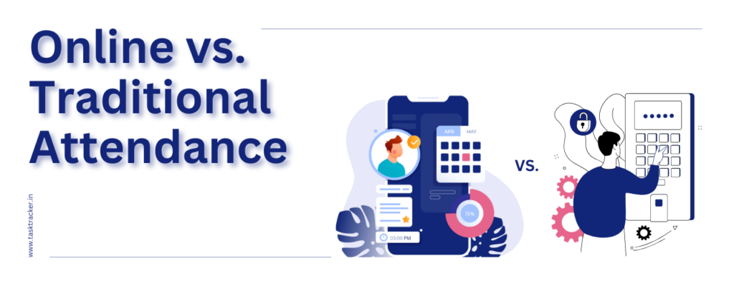
Advantages
Contactless and Efficient.
Accurate Tracking.
Security.
Time-Saving.
Real-Time Monitoring.

Slide 8
Literature Survey
S.No | Paper Title | Authors | Year | Methodology | Findings | Limitations
1 | Automated Attendance System Using Face Recognition | A. Sharma, B. Patel | 2020 | CNN-based facial recognition | Achieved 95% accuracy in controlled environments | Performance drops in low light conditions
2 | Real-Time Face Recognition for Attendance Using OpenCV | K. Singh, M. Verma | 2019 | OpenCV with Haar Cascade | Fast and lightweight implementation | Struggles with occlusions and angle variations
3 | IoT-Enabled Face Recognition for Smart Attendance | S. Das, L. Roy | 2022 | Raspberry Pi with cloud-based processing | Remote access and real-time monitoring | Requires stable internet connection
4 | Hybrid Model for Face Recognition Attendance System | J. Lee, T. Wong | 2023 | CNN + LBP for feature extraction | Improved accuracy under varied lighting | Increased processing time

